Slide 1

Data Science Team
Presentation
Sanaullah Khan
Hamzah Zafar Malik
Zeeshan Najeeb
Nadia Gull

Slide 2
Machine Learning and Python Training

Slide 3
Training Breakdown
Anaconda Distribution: Simplifies library/package installation and management
Jupyter Notebook: Preferred IDE for Python. Code can be executed in individual cell blocks.
Python Programming Language: User friendly. Worldwide language of choice for AI/ML development due to availability of libraries.
NumPy: Library that facilitates creation and manipulation of n-dimensional numerical arrays.
Pandas: Library for data manipulation, cleaning and preprocessing.
Matplotlib: Library for data visualization.
Scikit Learn: Library that facilitates easier implementation of ML models and algorithms.
TensorFlow/Keras: Library for implementation of advanced models and ML algorithms like Neural Networks.

Slide 4
Python
Basics of the language (syntax, indentations, etc.)
Data Structures
Conditional Statements and Loops

Slide 5
NumPy
Array creation
Array handling and manipulation

Slide 6
Pandas
Data indexing and selection
Operation on data
Handling missing data
Filtering Data
Data aggregation and grouping

Slide 7
Matplotlib
Data visualization
Creating and customizing plots

Slide 8
Scikit Learn
Training a machine learning model with Scikit Learn
Comparing machine learning models
Selecting the best model by cross validation
Selecting the best model parameters
Evaluating a classifier with Scikit Learn

Slide 9
TensorFlow/Keras
Deep Learning and Neural Network Introduction
Introduction to Tensorflow & Keras
Designing, training and evaluating a model
Saving and Loading a Keras Neural Network
Early Stopping in Keras to Prevent Overfitting
Extracting Weights and Manual Calculation

Slide 10
Training timeline
Week 1
Python
Week 3
- Intro to Git
- Pandas
Week 4
Pandas
Week 2
NumPy
Week 5
- Git/Github
- Matplotlib
Week 6
Intro to AI and ML

Slide 11
Training timeline
Week 8
Scikit Learn
Week 10
TensorFlow/Keras
Week 9
Scikit Learn
Week 11
TensorFlow/Keras

Slide 12
opencv
Open source computer vision programming library capable of numerous applications including:
Gesture recognition
Object identification
Object and motion tracking
Facial Recognition
Image analysis and processing
And much more..

Slide 13
web scraping
Data scraping, also known as web scraping.
It is the process of importing information from a website.

Slide 14
Python Libraries for Data Scraping
Python Requests.
Beautifulsoup.
Scrapy – The complete framework.
Selenium.

Slide 15
Data Scraped from Different Websites
Scraped Jobs from Indeed.com
Scraped phones data from flipkart.com
Articles information from coreyms.com

Slide 16
Git
Distributed version control system
Tracks changes in source code
Helps coordinate work among programmers
Can be used to track changes in any set of files

Slide 17
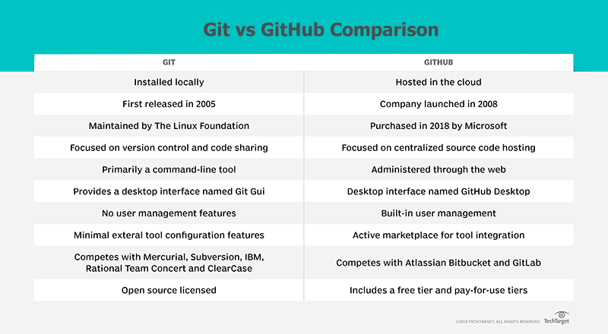

Slide 18
Digiskills project

Slide 19
Digiskills Project
Apply Machine Learning models on enrolment data provided by the applicants for predicting course completion
Apply Machine Learning models on data generated by the computer by the end of four weeks to predict course completion

Slide 20
Features selected for enrolment data
Feature Name | Role
Trainee ID | Primary Key
Joining Date | Input Variable
Joining Month | Input Variable
Joining Batch ID | Input Variable
Computer at Home | Input Variable
Employment Status | Input Variable
Familiar with Freelancing | Input Variable
Gender | Input Variable
Highest Qualification | Input Variable
Internet At Home | Input Variable
City ID | Input Variable
Region | Input Variable
District | Input Variable
Salary | Input Variable
Current Status | Input Variable
Future Plan | Input Variable
Course Complete | Target

Slide 21
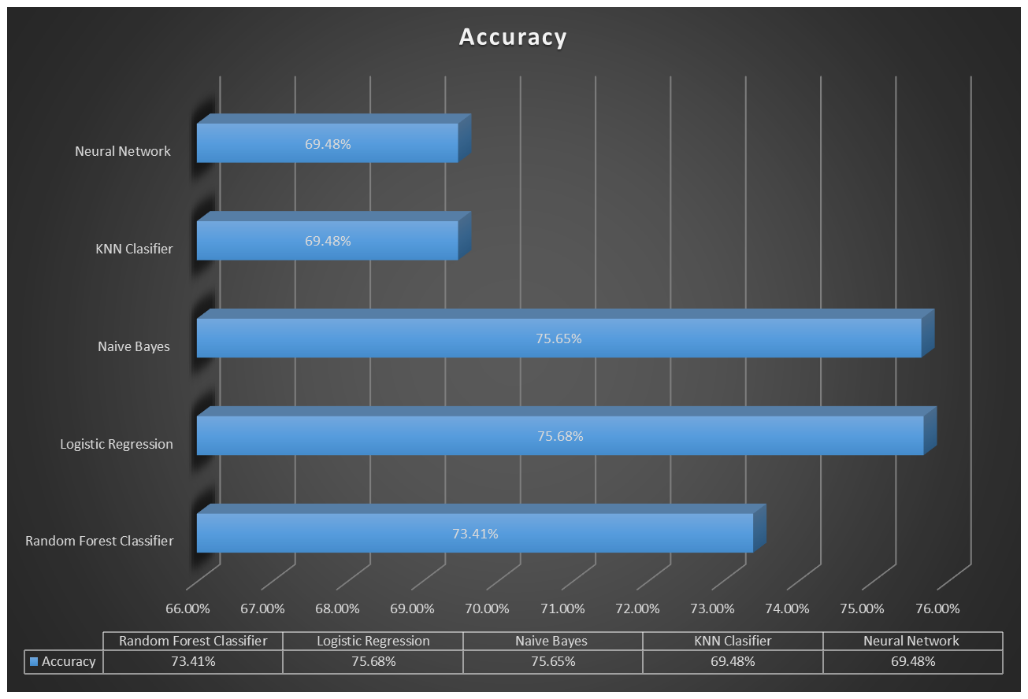

Slide 22
Features selected for 4-week data
Feature Name | Role
Trainee ID | Primary Key
Total Lesson Count | Input Variable
Lesson Viewed | Input Variable
Video Duration | Input Variable
Time spent watching videos | Input Variable
Total Quizzes | Input Variable
Quizzes attempted | Input Variable
Total Assignments | Input Variable
Assignments Submitted | Input Variable
Course Complete | Target

Slide 23
